Slide 1
Cloud Chamber
COMENIUS PROJECT AT GJAR, SLOVAKIA
Jaroslav Hofierka

Slide 2
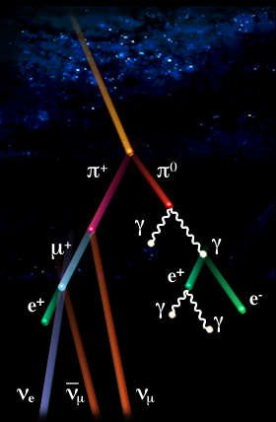
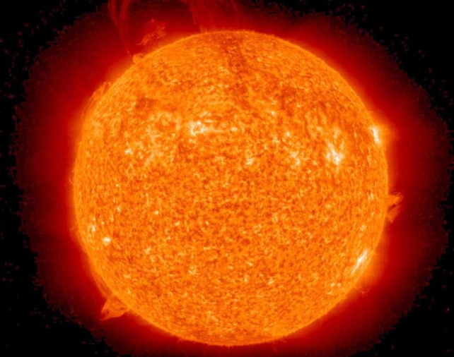
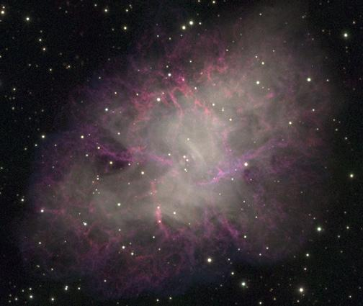
Background
Particles coming from the universe (cosmic rays) are crossing the earth all the time – they are harmless but invisible to us.
Cloud chambers are detectors to make the tracks of the particles visible.

Slide 3
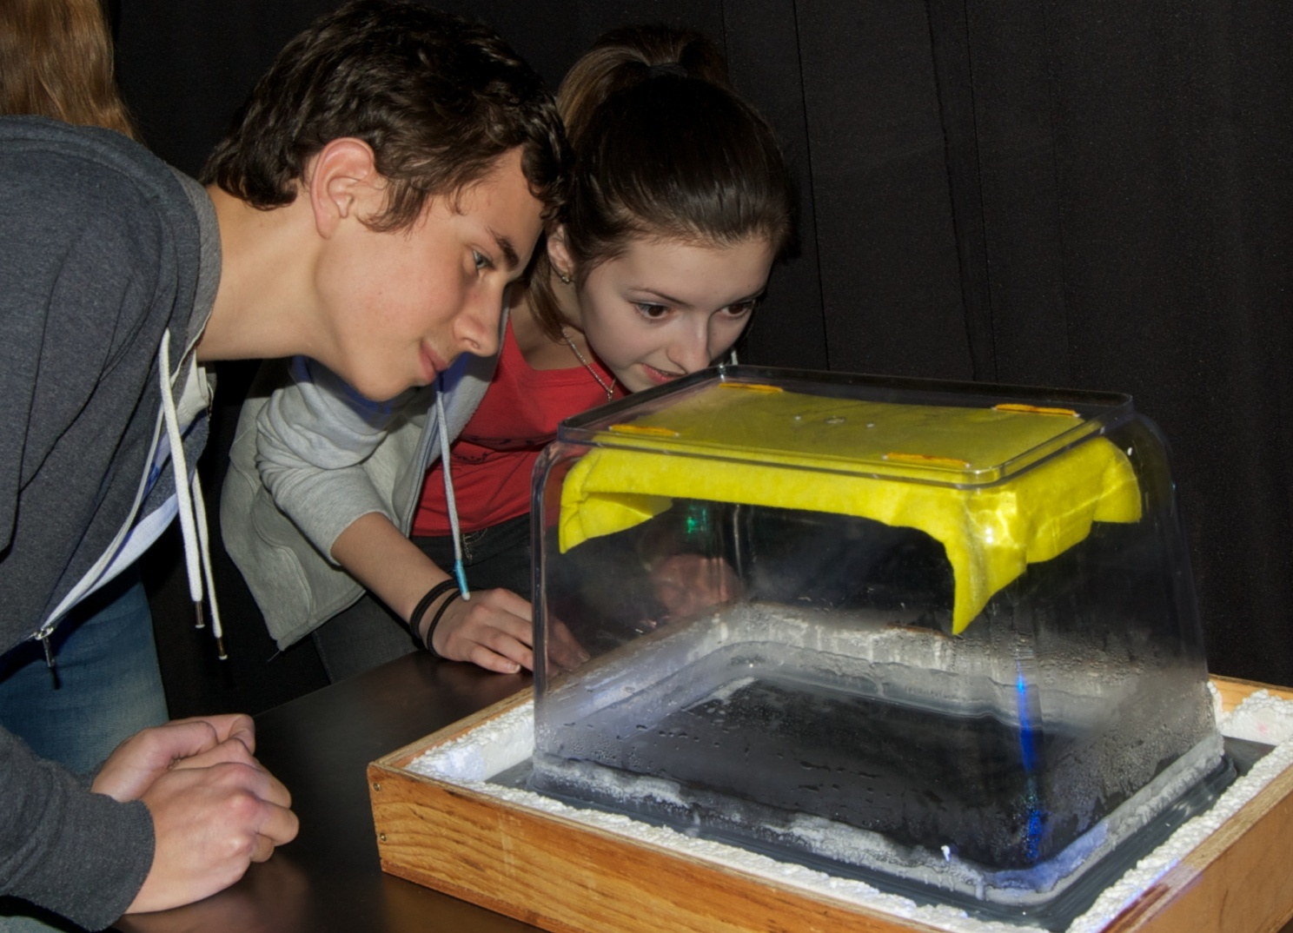
Our cloud chamber

Slide 4
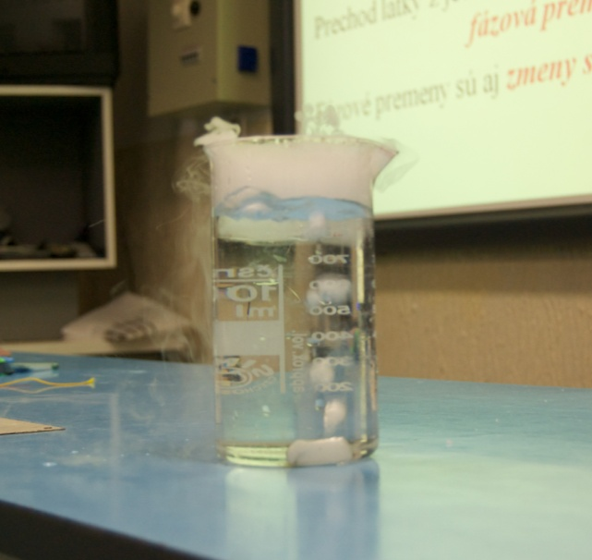
Key ingredients
Dry ice evaporating
Isopropyl alcohol (C₃H₇OH)
a colorless, flammable chemical compound with a strong odor
the simplest example of a secondary alcohol
a structural isomer of propanol.
miscible in water, alcohol, chloroform
can be oxidized to acetone, which is the corresponding ketone
produced by combining water and propene in a hydration reaction or by hydrogenating acetone
Dry ice (CO₂)
the solid form of carbon dioxide.
used primarily as a cooling agent.
useful for preserving frozen foods
sublimates at −78.5 °C at normal pressure.
While generally not very toxic, the outgassing can cause hypercapnia

Slide 5
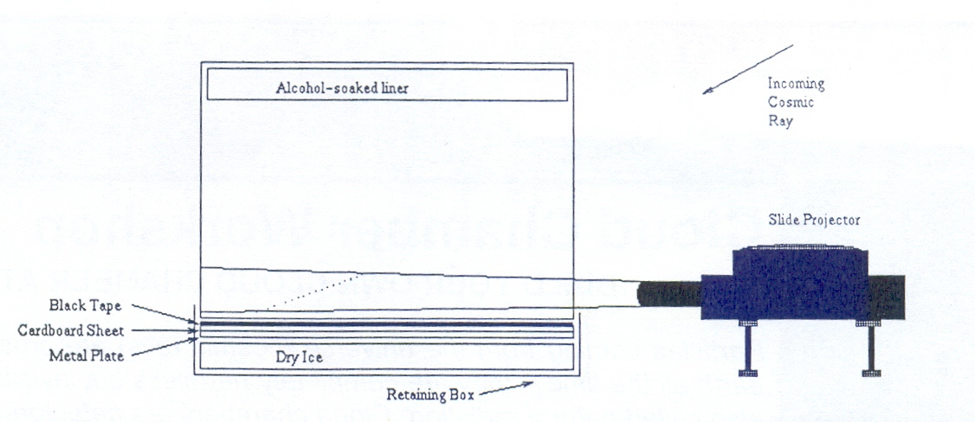
How it works (1)
As the top of the box is at room temperature, the alcohol evaporates from the felt and slowly sinks down. Because there is so much alcohol, the chamber will be saturated with alcohol vapour.
The dry ice keeps the bottom of the cloud chamber very cold – so that the vapor, once it has fallen, is in a so called supercooled state and will very easily condense into liquid form if anything disturbs its equilibrium.

Slide 6
How it works (2)
When a charged cosmic particle crosses the chamber, the particle will ionize the vapor: it tears away the electrons in some of the gas atoms along its path.
Small droplets of alcohol form along the path of the initial particle through the chamber. These droplets are the tracks we see appearing.

Slide 7
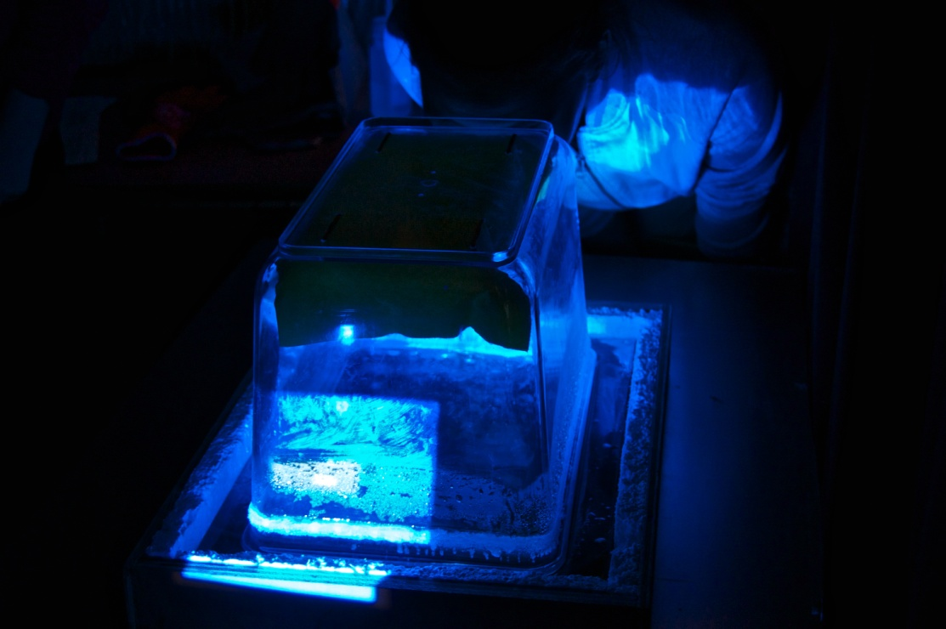
Our cloud chamber
Cosmic rays!!!

Slide 9
Thank you for attention!

