Slide 1
Help always comes from our HEART
International Comenius Project at GJAR
From matter of the heart
To the heart of matter.

Slide 2
Charity
MAGIS is a non-profit charity organization which focuses on social work, especially helping women in need and low-income families.
The name MAGIS comes from Latin and means “more”.
http://www.congregatiojesu.com/

Slide 3
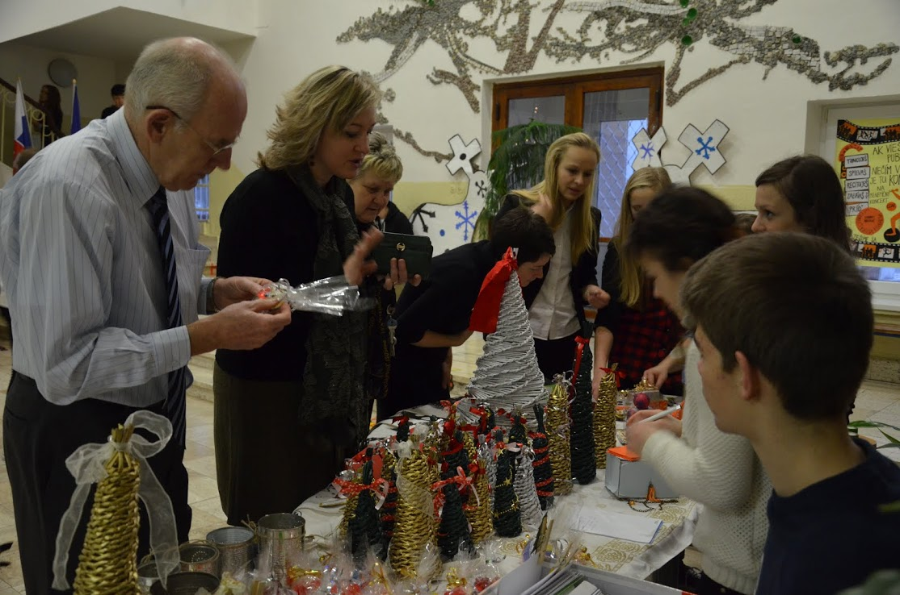
What have we actually done?
Our school got in touch with MAGIS and tried to help them in some way.
The idea was simple: to produce something, sell it at school and so to earn some money for the organization

Slide 4
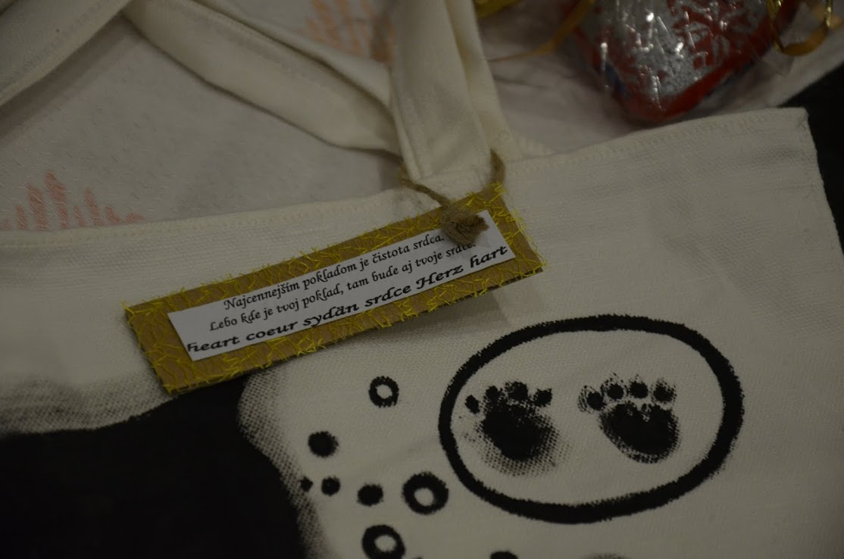
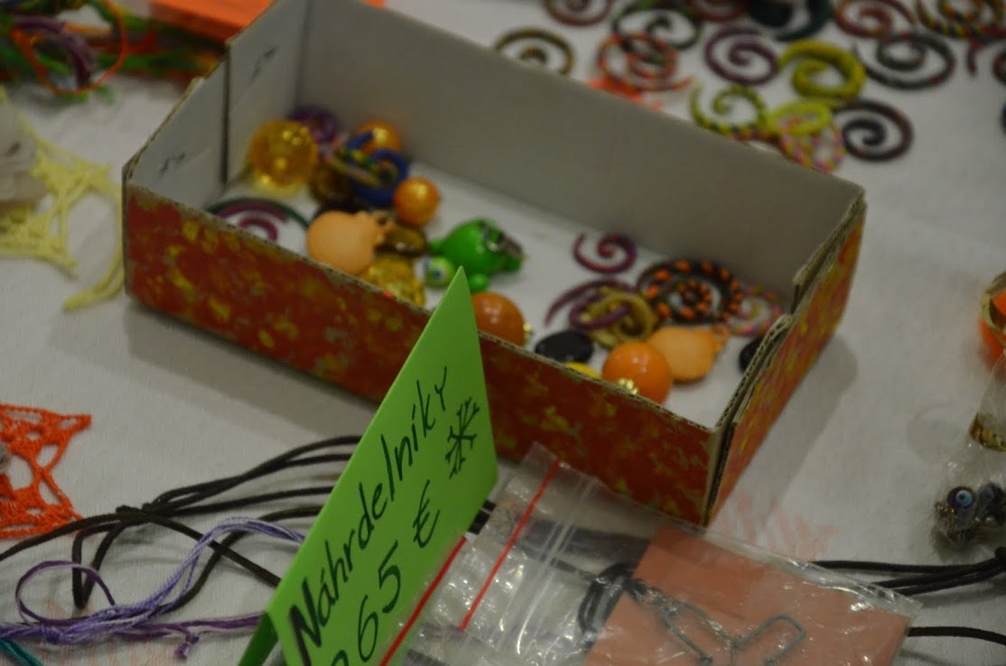
Our products
After all, we decided to make:
▪ soaps in the shape of heart,
▪ Christmas decorations like small trees,
▪ patterned cloth bags,
▪ some bracelets, earrings...

Slide 5
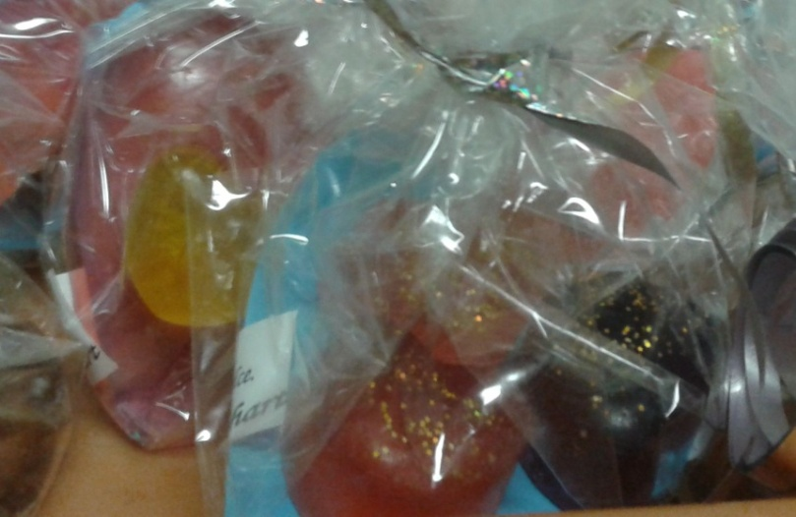
Soap
a chemical-physical process
Basic ingredients for soap are oils/fats, which represent acids, and sodium hydroxide(NaOH) or potassium hydroxide(KOH) representing bases.
Soap is a salt of fatty acids, i. e. it is the product of acid-base reactions.

Slide 6
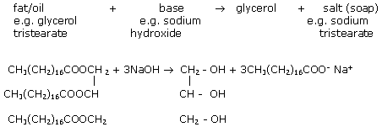
Chemical reaction
Triglycerides are called fats if they are solid at room temperature and oils if they are liquid at room temperature.
When triglycerides are reacted with sodium hydroxide, the bond between the oxygen atom of the carboxylic acid group and the carbon atom of the glycerol is broken. This process is called saponification.

Slide 7
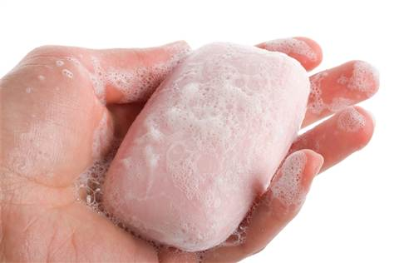
Unique properties of soap
One end of the chain is water soluble (hydrophilic) while the other end is not (hydrophobic).
In the process of washing with soap, a particle of grease is surrounded by soap molecules. The hydrophobic ends attach to the grease particle, thus leaving the hydrophilic end exposed to the water. This allows the grease particle to freely move around in the water and, therefore, be washed away.

Slide 8
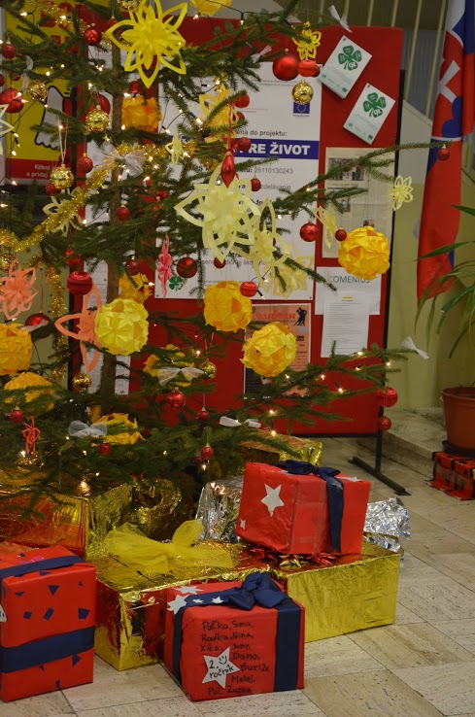
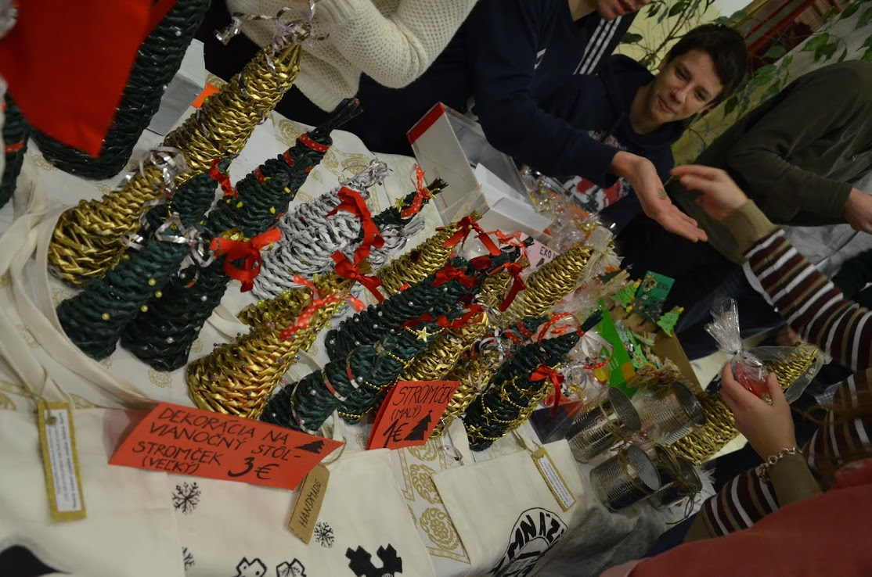
...and because Christmas is traditionally the best time for giving and helping those in need...

Slide 9
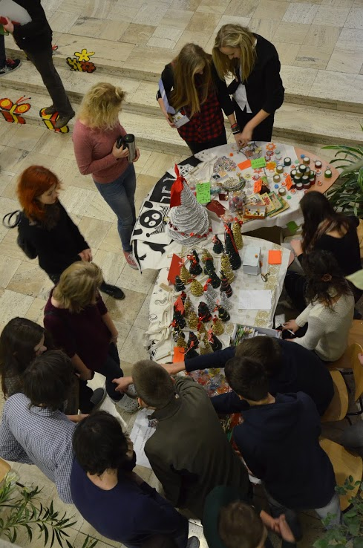
In practise...

Slide 10
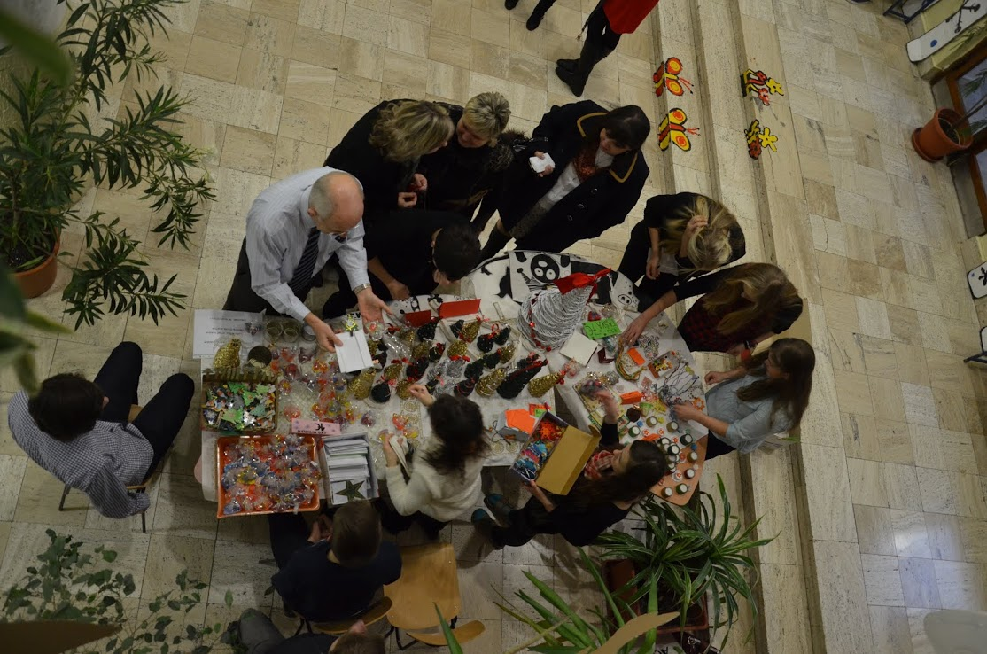
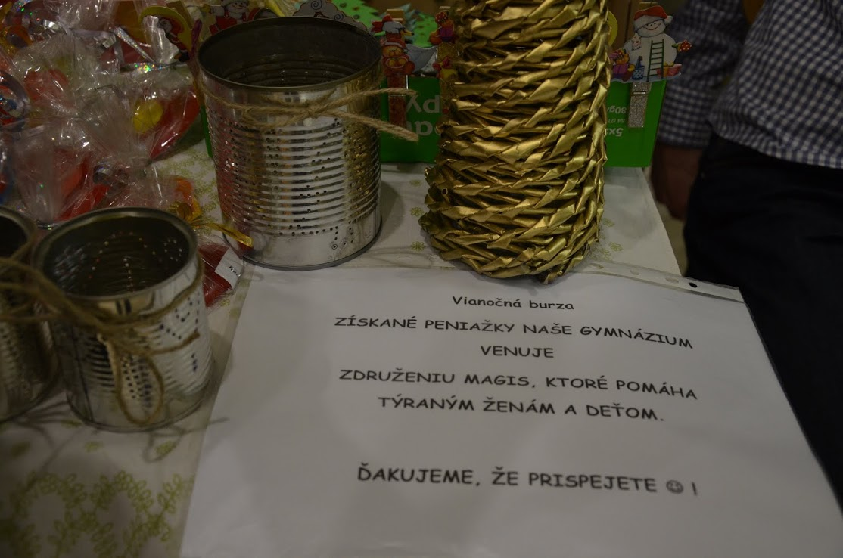
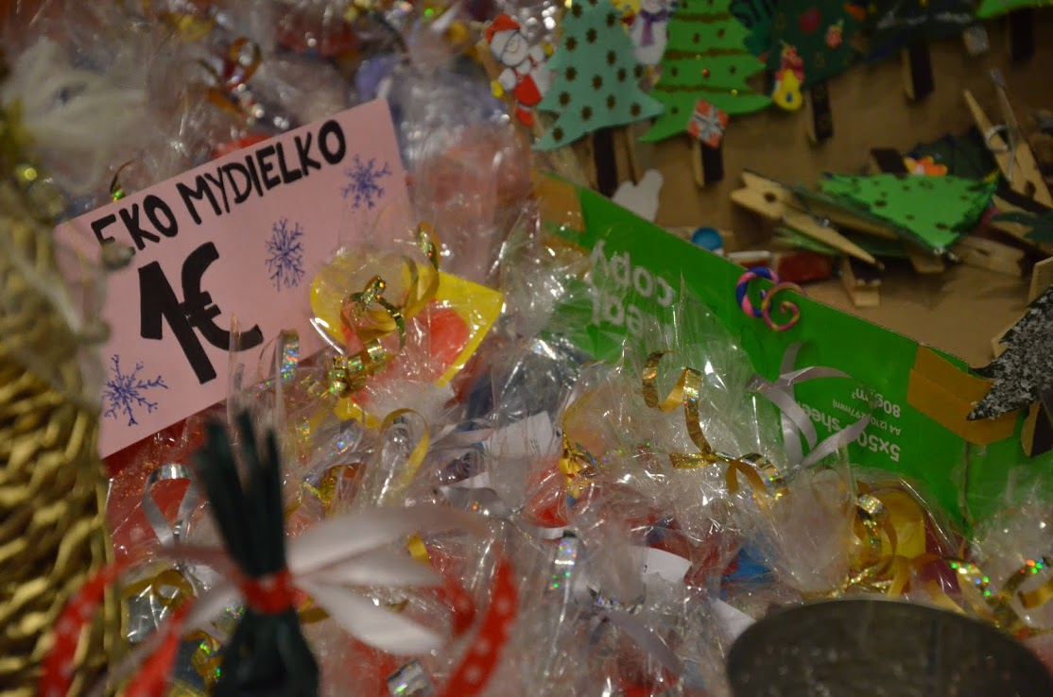
We informed students who would be donated with earned money.

Slide 11
What have we achieved?
Our school collected 219,78 €.
Money was used to help 60 families in need in Slovakia during Christmas.
People were given food like bakery products, pulses, pastas, dried fruits and some sweets for Christmas tree...

